Slide 1


Data wrangling/cleaning using Excel

Slide 2


Data analytics workflow review
Define business problem
Data collection
Data cleaning
Data exploration
Data processing
Models generation
Model evaluation
Show final results

Slide 3
Data gathering
The data can be come from different sources and be split in several files which we might have to combine.
We can read all the csv files with excel into independent sheets.
Combine all the data from multiple sheets into one.

Slide 4
Functions to import data in Excel ImportRange and Indirect
ImportRange:
This function allow us to insert data in the which is into another sheet of the workbook
Indirect(ref)
This function imports the data from the cell referenced in the cell “ref”
 | A | B
1 | B1 | 1,333
2 | B3 | 45
3 | George | 10
 | =INDIRECT(A1)->1,333
https://support.microsoft.com/en-us/office/indirect-function-474b3a3a-8a26-4f44-b491-92b6306fa261

Slide 5
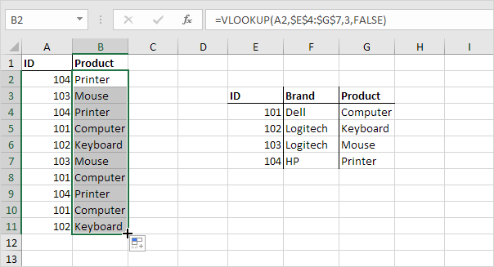
Function Vlookup
The VLOOKUP (Vertical lookup) is a function which given a value in one table, finds the same value in another table.
VLOOKUP(value_to_search , range_for search, column_to_import, na_values )
https://www.excel-easy.com/functions/lookup-reference-functions.html
In the example on the right image we would like fill out the “Product” column “G” according to the product “ID” with the values on column “B”
VLOOKUP(E4,$A$1:$B$11,2,0)
In case of duplicates, vlookup returns the first match.

Slide 6
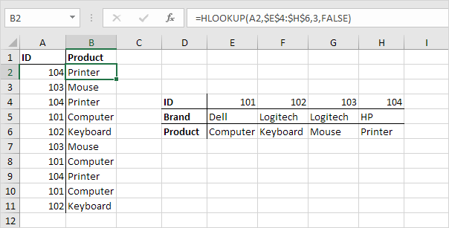
Function Hlookup
The HLOOKUP (Horizontal lookup) is a function which given a value in one table, finds the same value in another table horizontally.
HLOOKUP(value_to_search , range_to_search, column_to_import, na_values)
https://www.excel-easy.com/functions/lookup-reference-functions.html
In the example on the right, we want to fill the second table with the product name.
HLOOKUP(E4;$A1:$B11;2;0)

Slide 7
Primitive data types:
There are five main types of data types:
Booleans: (True/False, Male/Female, Default/Not Default,....)
Characters: (‘A’, ’c’, ‘D’,...)
Strings: (sets of characters: “Home”, “I like my dog”,...)
Integers: (-1, 2, 5, 400,...)
Floating point: (-13.5, 26.8, 13E6,...)
00

Slide 8
Data cleaning process
Data cleaning is mandatory as in data analytics the main rule is:
“Garbage in/ Garbage out”
We need to clean our data, but this is a needed condition but not sufficient ir order to guarantee a good model.
Every model may need a different preprocessing.
00

Slide 9

Data cleaning
Standardizing header names
Deleting and rearranging columns
Working with data types (setting the right types)
Filtering data
Removing duplicates (redundant, they don’t add info)
Correct typos
Conditional Formatting
Replacing null values (most of models are not able to handle them)
00

Slide 10
Data cleaning in Excel using string functions
LEN( cell_name ): provides the length of the characters found in “cell_name”
LEFT( cell_name, number_of_characters ): returns “number_of_characters” of “cell_name starting from the left
RIGHT( cell_name, number_of_characters ): returns “number_of_characters” of “cell_name starting from the right
MID( cell_name, start, number_of_characters): returns “number_of_characters” from “cell_name” starting from “start” position
FIND( cell_name, “string”): if “string” exists in “cell_name”, returns the starting position
IF ( condition, value_if_true, value_if_false ). It can be nested with another “IF” inside the function.
https://www.edupristine.com/blog/text-functions-excel

Slide 11
Data standarization
What is it?
All the values need to follow the same format, units, code...
Why is needed?
To allow any model to extract meaningful patterns.
If we want to train a model that depends on distances, different ranges of values in each column favor the column with the biggest range in predicting the dependent variable. (the remaining columns are barely used in the prediction)

Slide 12
Excel limitations
Small files
Excel has limited amount of machine learning models
Total number of rows and columns on a worksheet
1,048,576 rows by 16,384 columns
00

